Slide 1



UNIT 5: Where I live
Where am I?

Slide 2
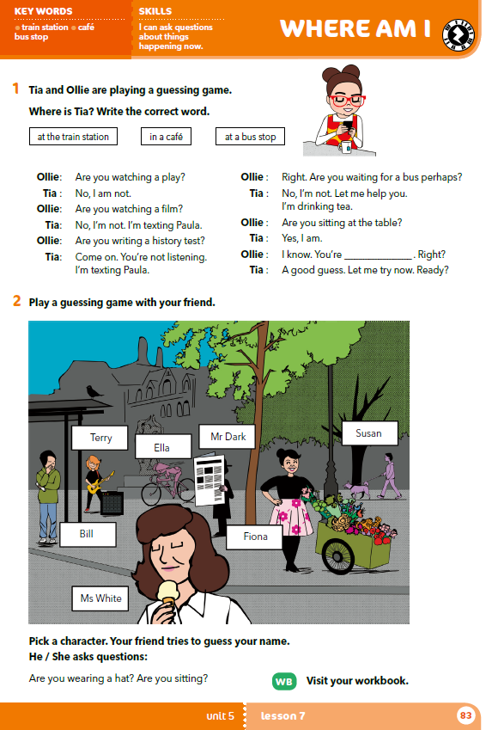
What can you see?
Where is Tia?
What is she wearing?
What is she doing?

Slide 3
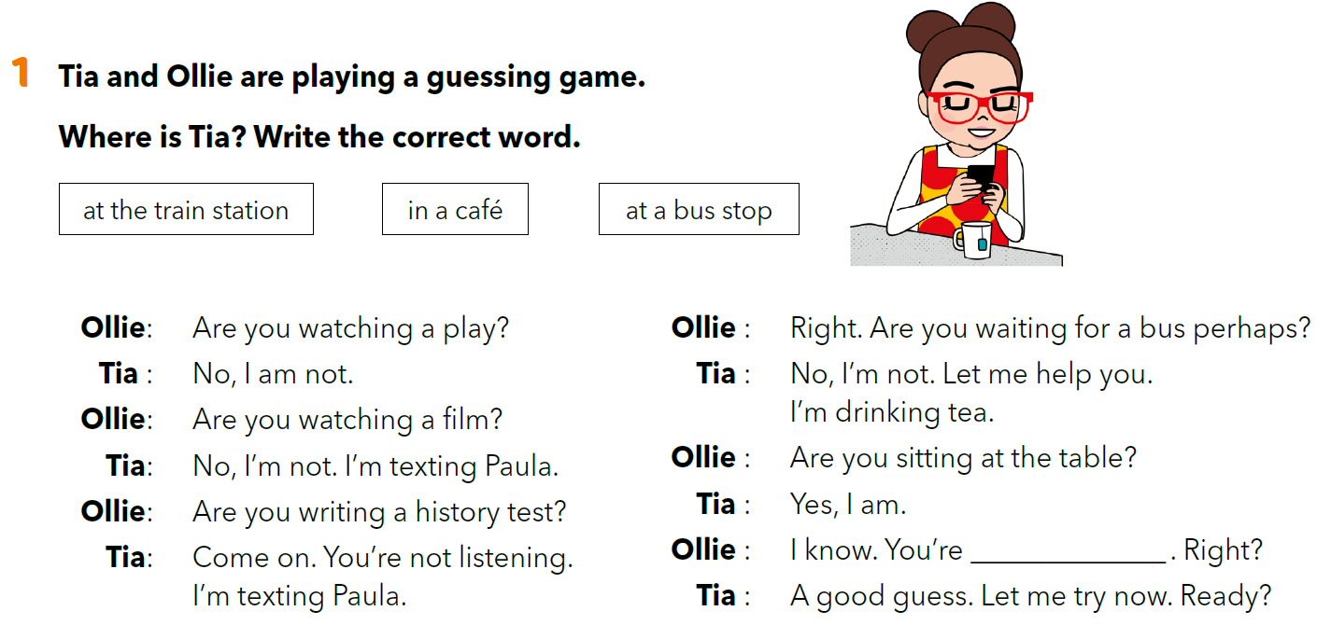
Read the dialogue and fill in the gap with the correct word.
in a café

Slide 4
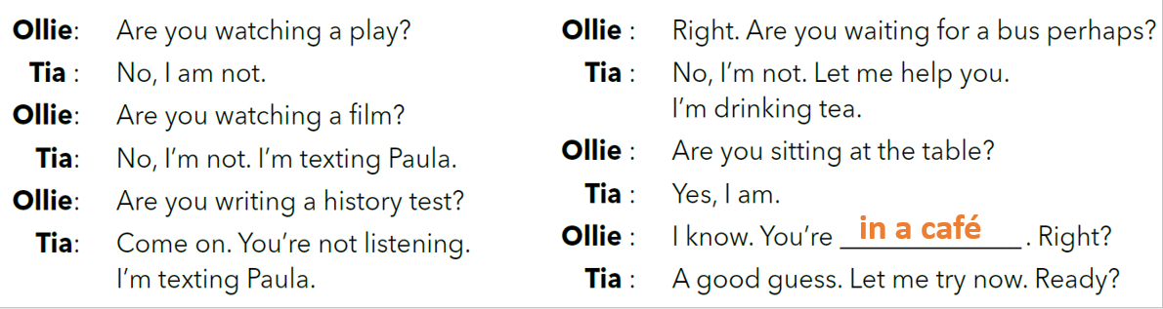
Let’s practise!
Read the dialogue aloud in pairs. Read the dialogue a few times using different voices (e.g. as if you were: a robot, very tired, very sad, very happy, winded, chewing a bubble gum, …).

Slide 5
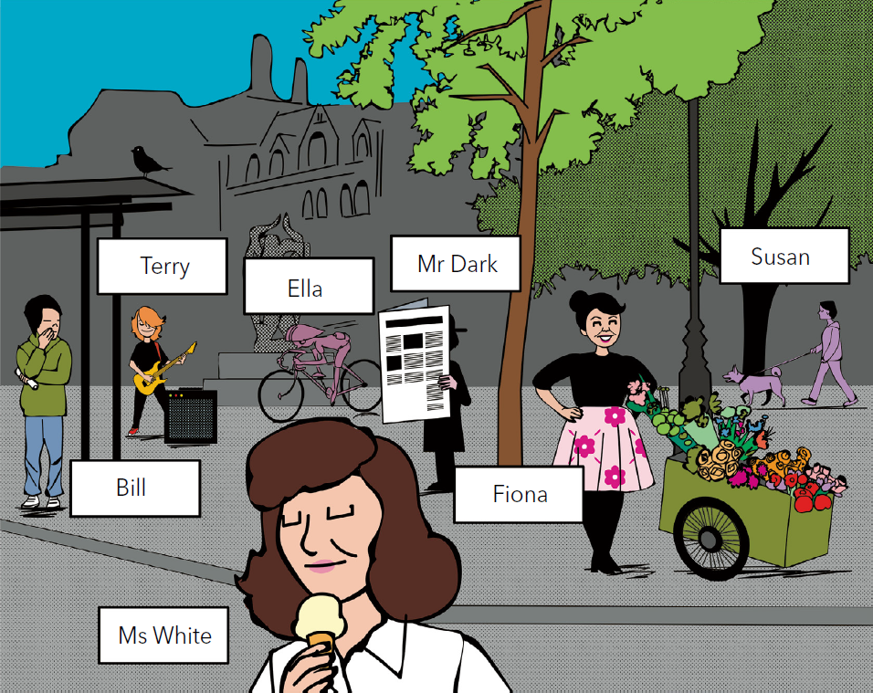
Describe the picture in pairs. Name as many details as you can.

Slide 6
Play the guessing game.
Your teacher picks a character.
Your task is to guess the name of the character.
Ask at least 5 Yes / No questions and after that try and guess the name of the character (e.g. Are you wearing a hat? Are you sitting?...)
(npr. Are you wearing a hat? Are you sitting?...)
If your teacher’s answer is yes, you can ask the next question.
If your teacher’s answer is no, another student asks the next question.
The student who guesses the name of the character picks a character and the rest of students ask the questions and try and guess the name.

Slide 7
Work in a group (6-7 students). Think of a playground scene (e.g. Ana is talking to Ida. Luka is playing with a ball. Marko is jumping… etc.) or the classroom scene (e.g. Marko and Luka are playing a computer game. Ana is doing homework. Ida is reading a book.) which you can describe in English.
Mime the scene and take a photo of it.
Give the photo to other groups who then use the photo and play the guessing game. One student chooses a person and the rest of them ask questions and try to guess the name.

Slide 8

Another option
Choose a person from one of the following pictures. The rest of the students ask questions and guess which person you chose.

Slide 9
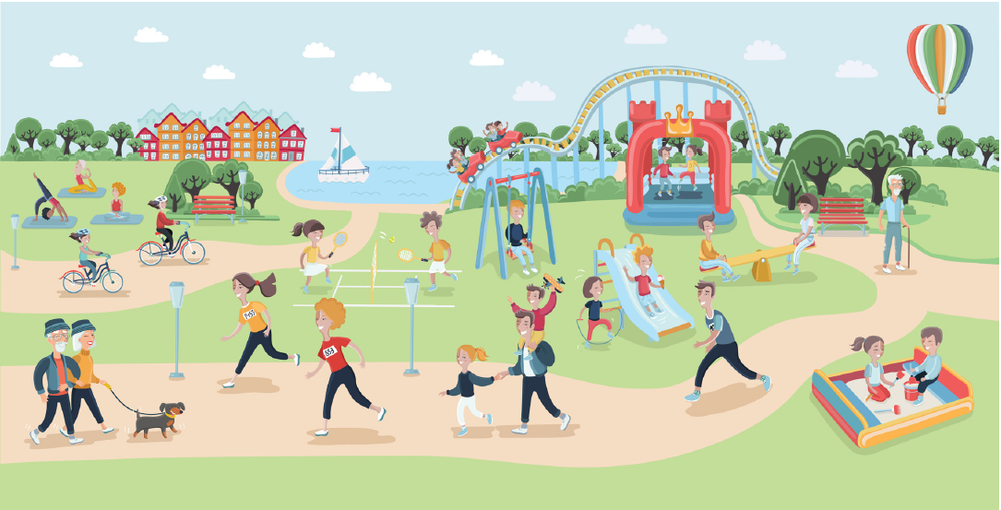

Slide 10
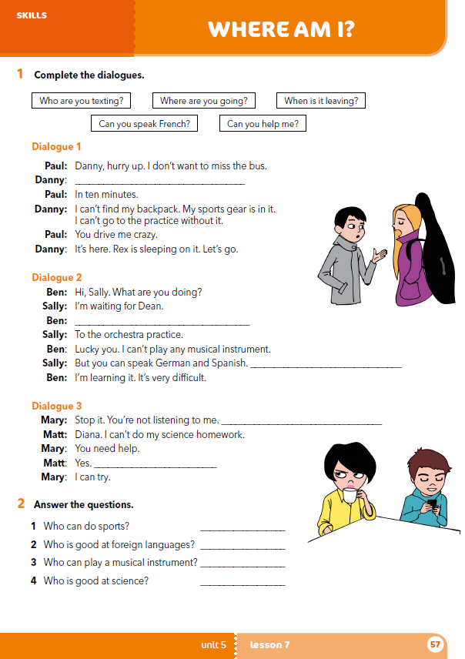
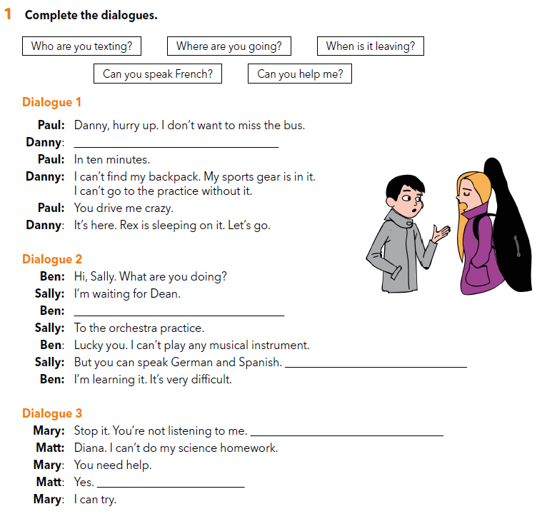
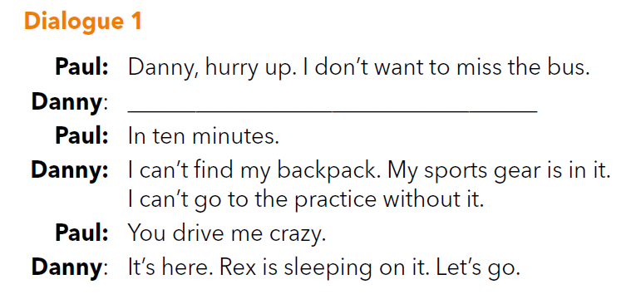
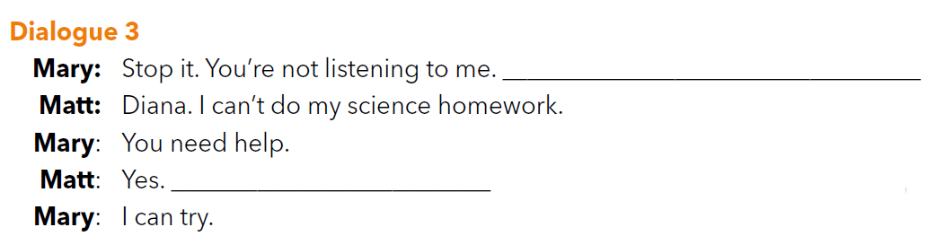
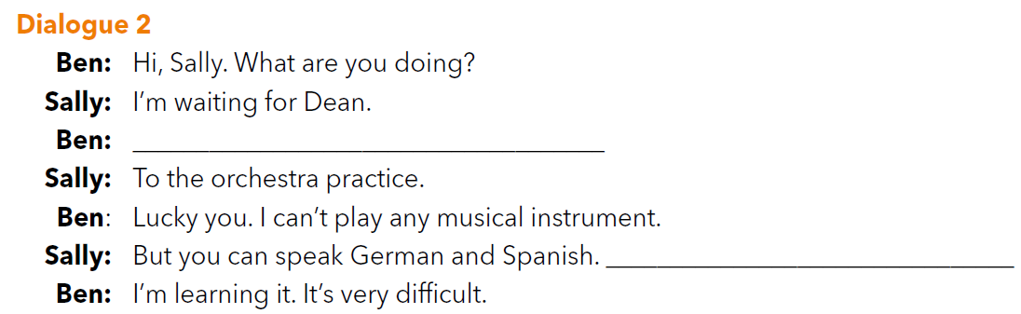
workbook p. 57
When is it leaving?
Who are you texting?
Can you help me?
Where are you going?
Can you speak French?

Slide 11
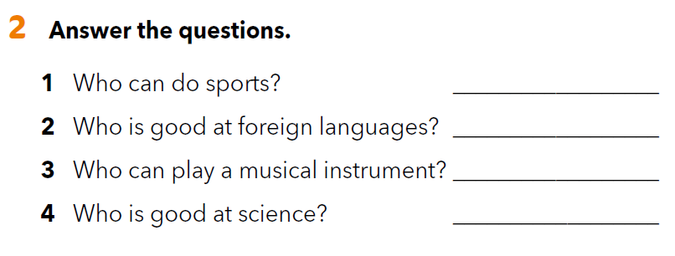

Slide 12
LET’S REVISE!
Where am I?
Read the sentences and choose the correct answer.
https://wordwall.net/resource/260169/where-am-i

